Slide 1
Trends in U.S Wage Inequality: Revising The revisionists
By: David H. Autor, Lawrence F. Katz, and Melissa S. Kearney (2008)

Slide 2
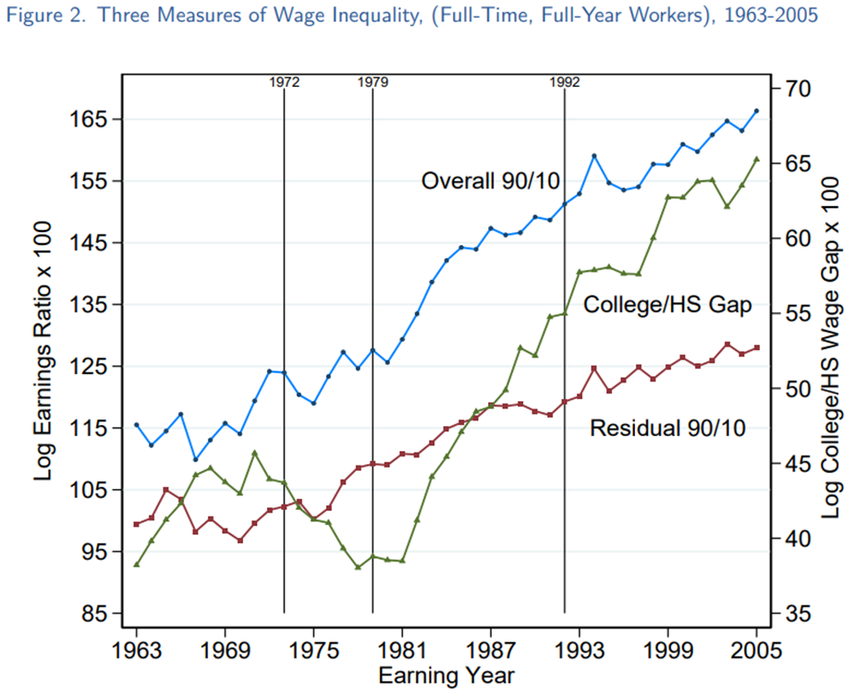
Introduction to Topic
Several studies find that the rise in U.S. wage inequality during the 1980s can in part be explained by shifts in the supply of and demand for skilled workers (Katz and Autor 1999; Goldin and Katz 2001).
The literature argues that the rapid increase in wage inequality during the 1980s reflected an ongoing secular rise in the relative demand for skilled workers (Juhn, Murphy, and Pierce 1993) which, when met with a dramatic slowdown in the relative supply of skilled workers, caused the wage gap to expand rapidly (Katz and Murphy 1992)
Further studies find that the decline of labor unions and a falling real minimum wage also contributed to the rise of wage inequality during the 1980s (DiNardo, Fortin, and Lemieux 1996; Card, Lemieux, and Riddell 2003)

Slide 3
Claims by the revisionist
Card and DiNardo (2002) argue that the rise of inequality during the 1980s is largely explained by nonmarket factors, most prominently, the declining real value of the minimum wage
, Card and DiNardo conclude that the growth of U.S. earnings inequality was primarily a one-time (“episodic”) event of the early 1980s, which plateaued by the mid-1980s and did not recur.
Lemieux (2006b) concludes that the rise of residual inequality in the 1980s was also an episodic event accounted for by the declining value of the minimum wage and that apparent increased residual inequality since the mid-1980s reflects the mechanical effects of the changing labor force composition (rising education and experience).

Slide 4
Autor, Katz, and Kearney Revising the Revisionist
If the rise of U.S. earnings inequality was a brief, nonrecurring episode of the early 1980s, the probable causes are likely to be one-time precipitating events such as the 1980s decline in the real minimum wage.
Alternatively, if the growth of earnings inequality reflects a long-term movement toward greater dispersion of earnings and higher skill differentials, then it is more likely to be explained by fundamental, secular factors, affecting the supply of and demand for skills

Slide 5
Data
I use data from the March Current Population Survey (CPS), for survey years 1964 to 2020 (covering earnings from 1963 to 2019).
I focus on workers who:
are 16 to 64 years of age (in the earning year)
have 0 to 39 years of experience
are full­time workers, those working “35­ plus” hours per week in the prior year
are full­-year workers, those working “40­ plus” weeks in the prior year
Weekly earnings equals the log of annual earnings divided by weeks worked last year.
All calculations are weighted by CPS sampling weights and weekly earnings are deflated to earnings in 2000 dollars using the personal consumption expenditure (PCE) deflator.

Slide 6
Methods
Autor, Katz, and Kearney (2008) revise two claims :
(i) that the growth of inequality was an episodic rather than secular phenomenon
(ii) that the growth of inequality is explained largely by nonmarket forces and the mechanical effects of labor force composition changes.
To revise the first claim, we look at the evolution of wage inequality in the U.S
We look at changes in :
Overall inequality – (90/10) wage differential
Upper tail inequality – (90/50) wage differential
Lower tail inequality – (50/10) wage differential
We also look at changes in:
Between group inequality - college/high school wage differential
Within group (residual) inequality - (90/10) residual wage differential
If the growth of wage inequality reflects an ongoing secular trend :then it is more likely to be explained by fundamental, secular factors affecting the supply of and demand for skills.
I also estimate OLS regressions on the college/high school wage differential and incorporate the shifts in the supply of and demand for skilled workers.
For the second claim, we partly look at the effect f nonmarket forces, such as the declining real value of the minimum wage and its impact on the college/high school wage differential.

Slide 7
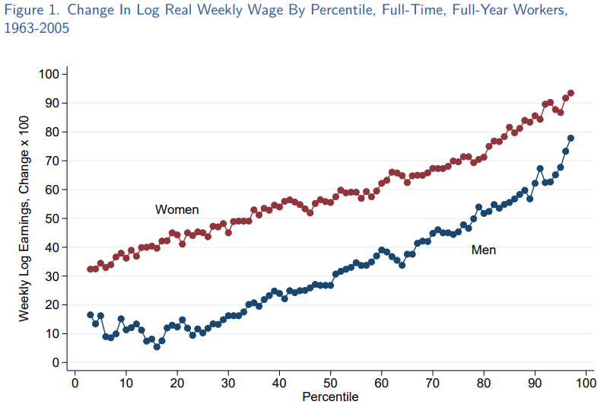
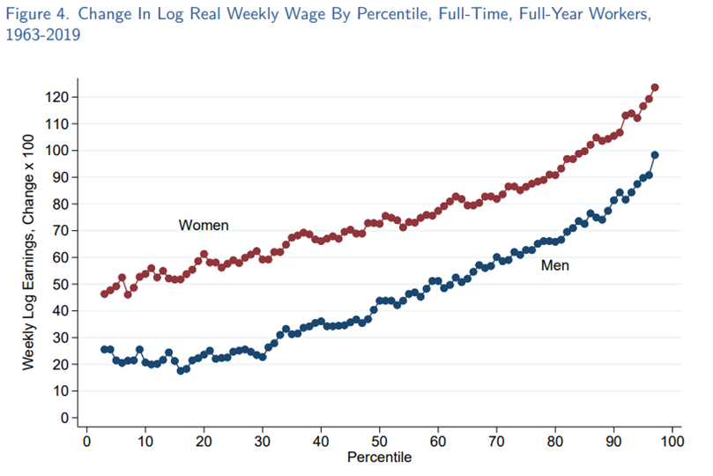

Slide 8
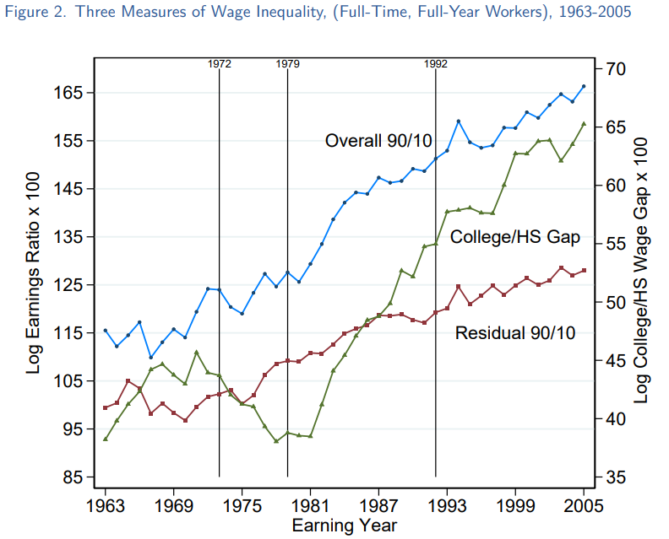
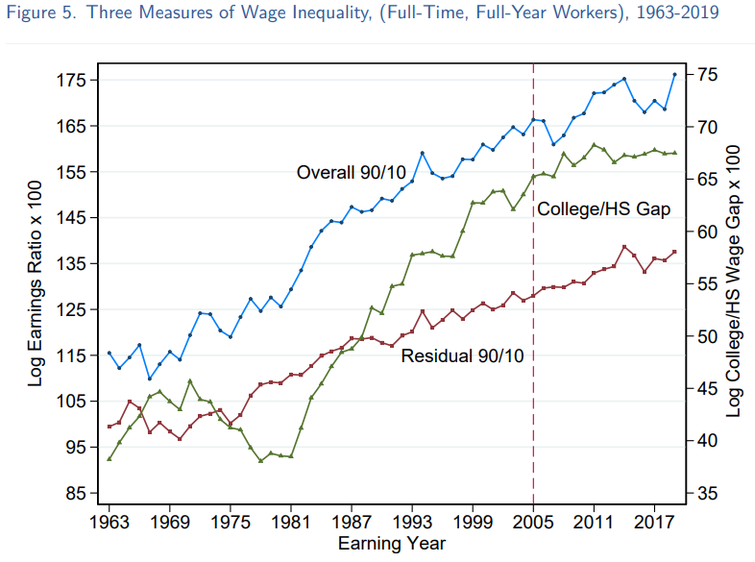

Slide 9
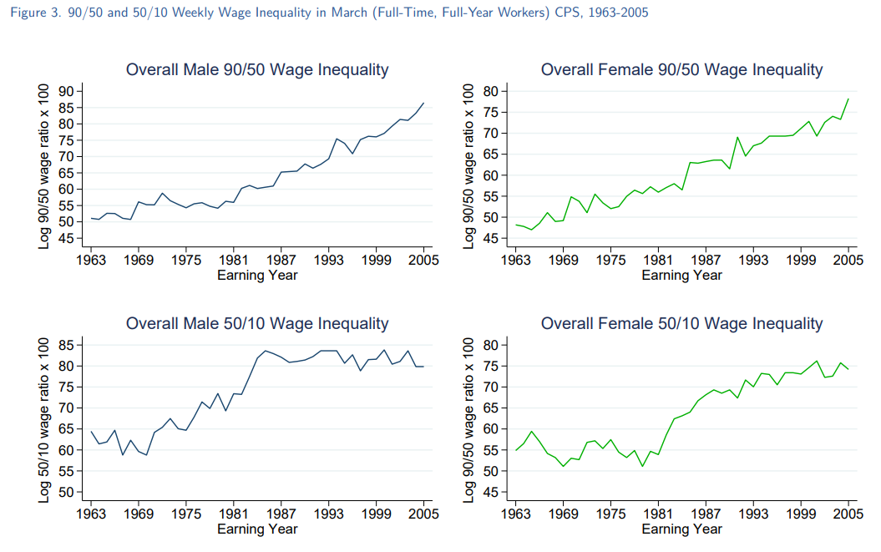

Slide 10
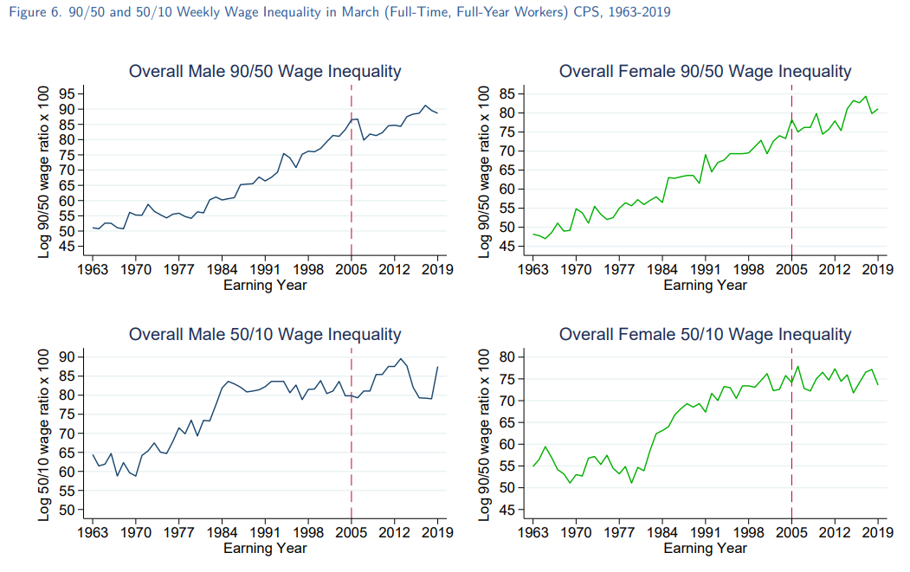

Slide 11
Summary of Figures
The rapid growth of wage inequality in the lower half (50/10) of the wage distribution during the 1980s seems to have been episodic event that has not reoccurred.
However, for upper tail (90/50) groups wage inequality increases steadily from the 1980s and onward, demonstrating a secular that has been ongoing for 57 years.
This conclusion counters the first claim by the revisionist“(i) that the growth of inequality was an episodic rather than secular phenomenon”

Slide 12
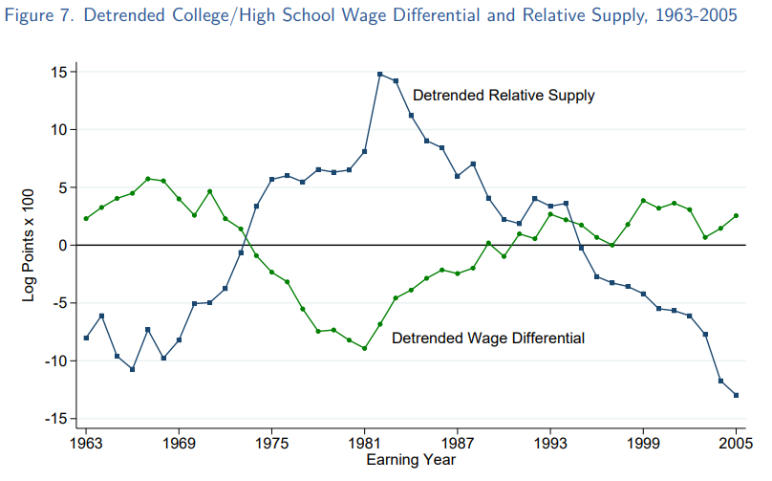
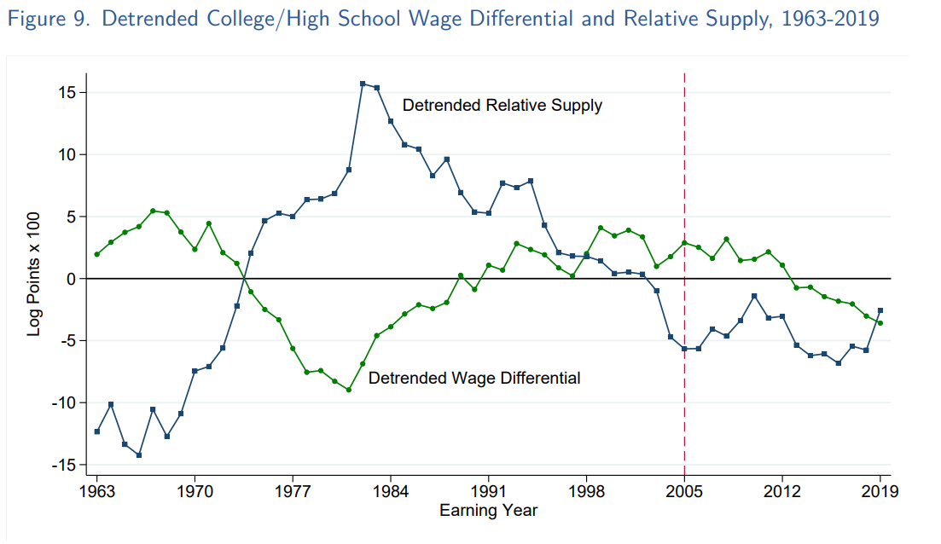
Sources of the Rising College/ High School Wage Premium

Slide 13
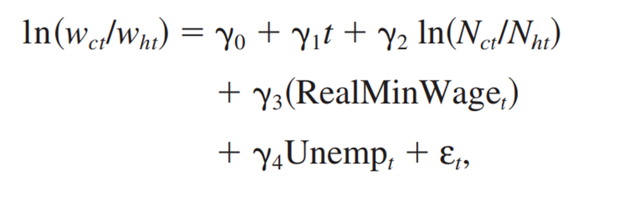
Sources of the Rising College/ High School Wage Premium

Slide 14
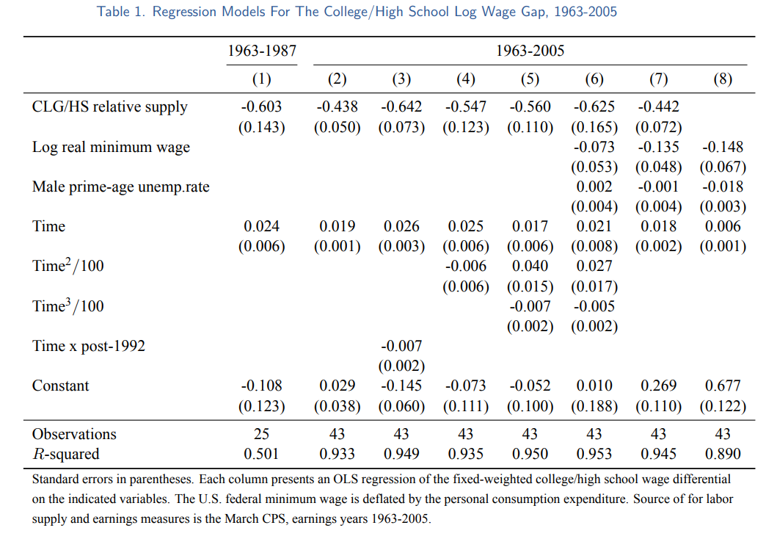
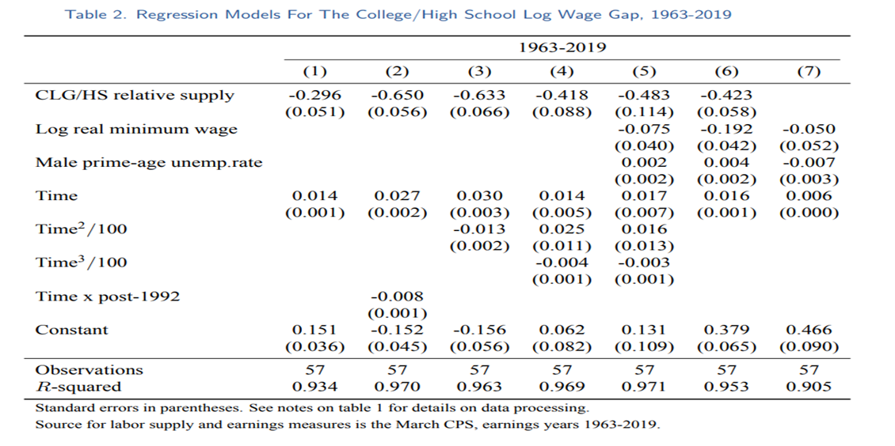

Slide 15
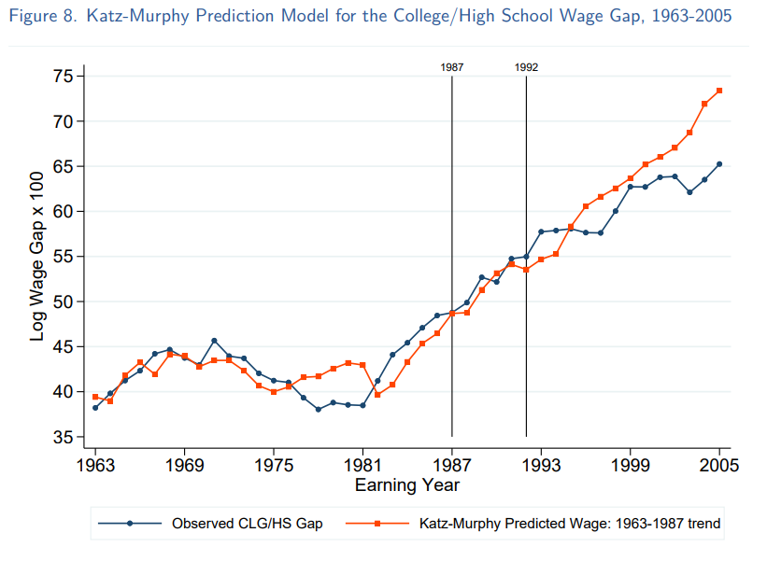
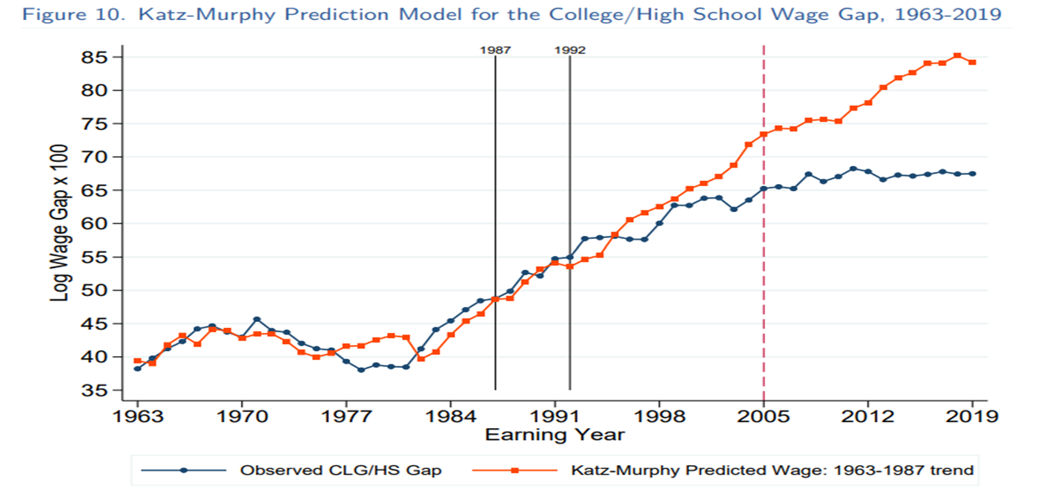

Slide 16
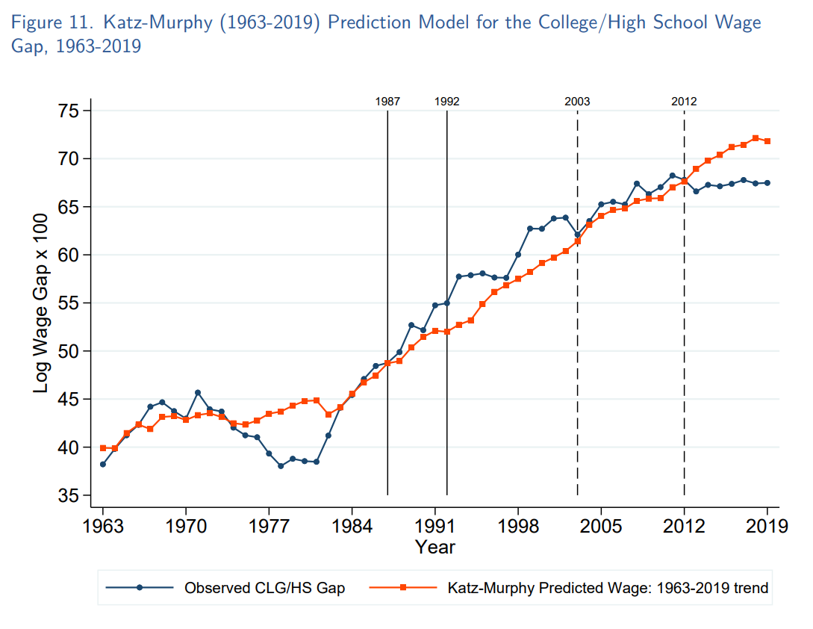

Slide 17
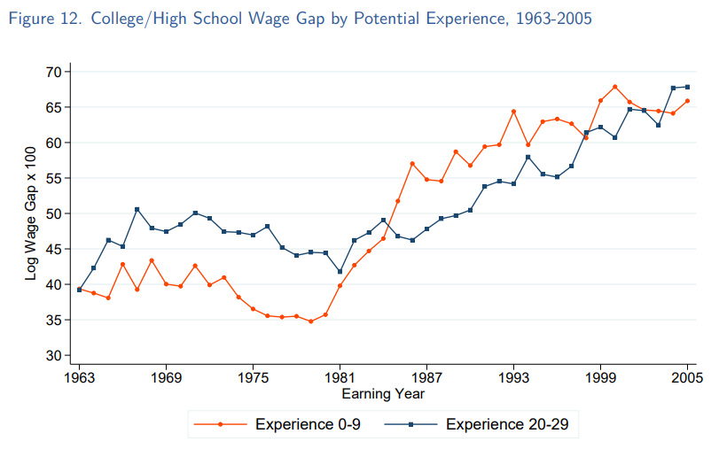
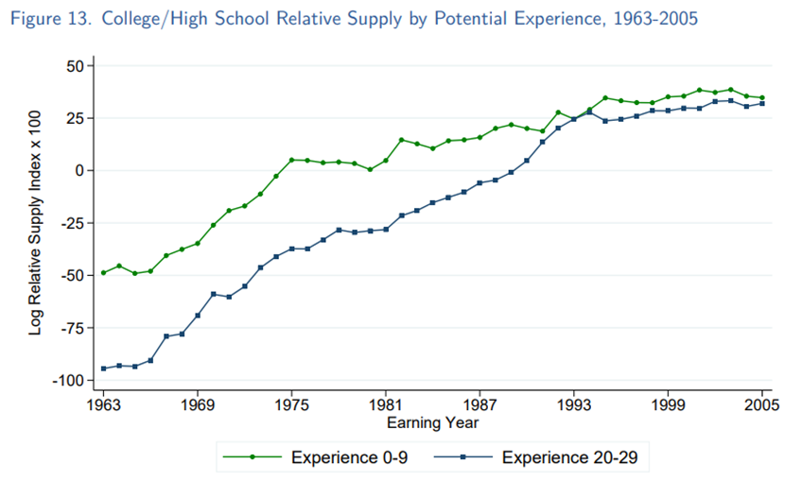
College/High School Wage Premium by Experience

Slide 18
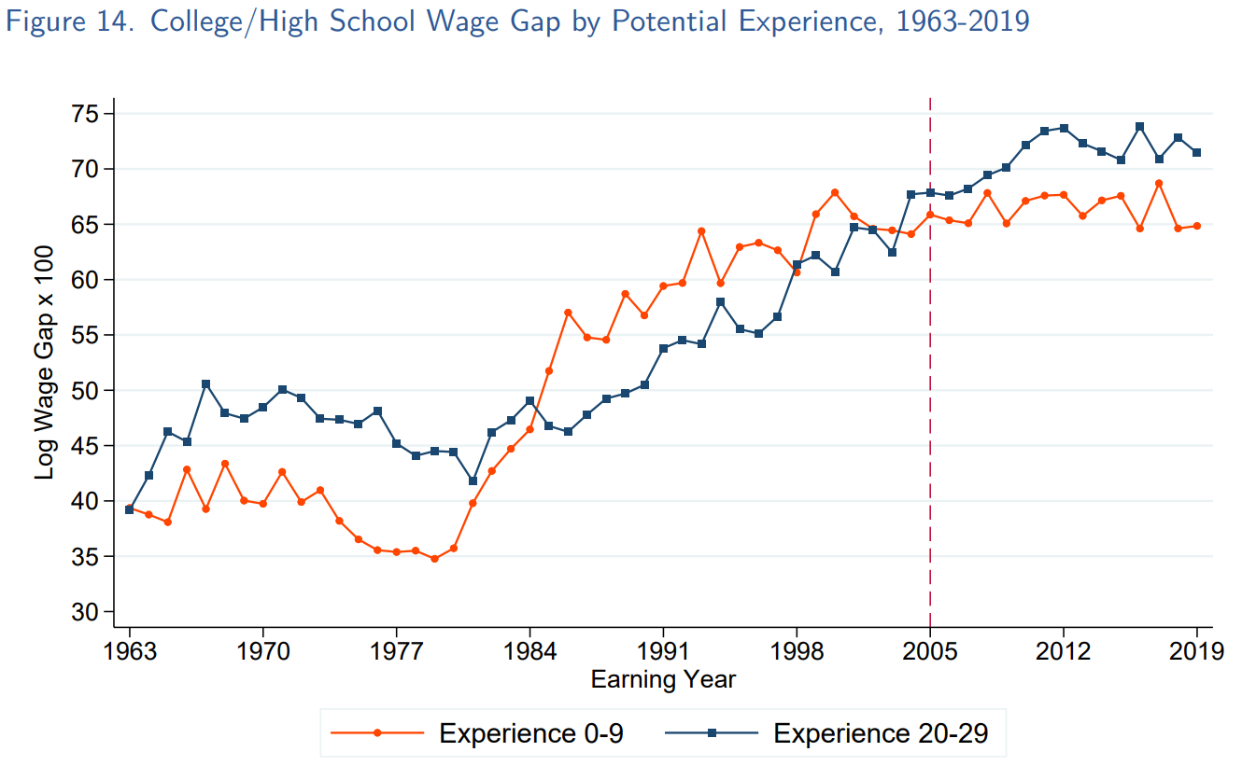
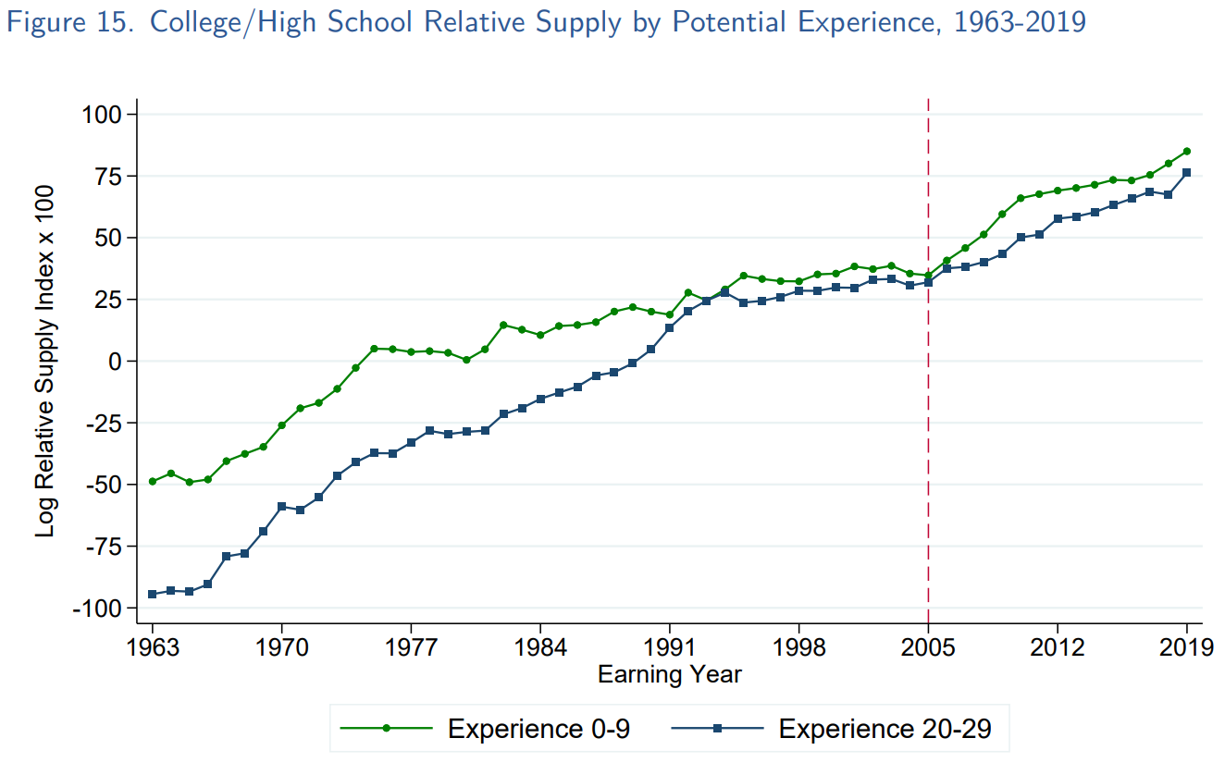

Slide 19
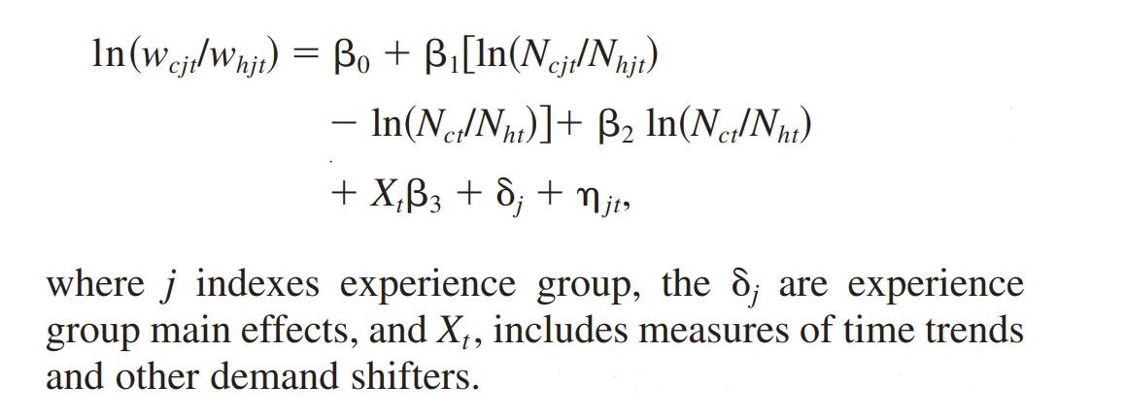
College/High School Wage Premium by Experience

Slide 20
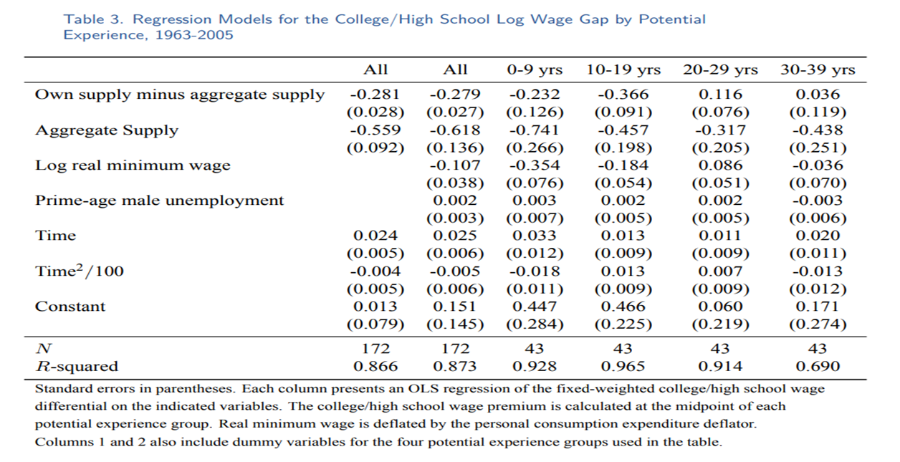
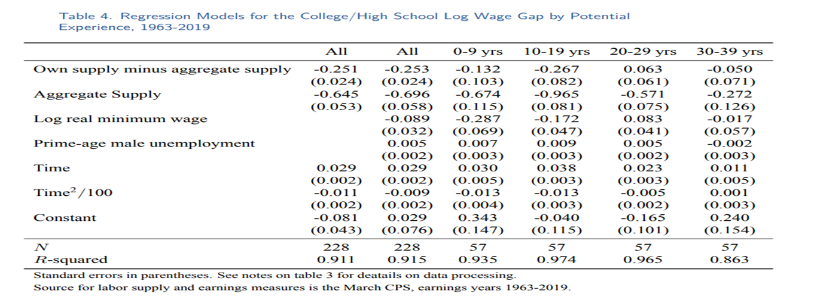

Slide 21
Conclusion
The growth of wage inequality is not accurately described as an episodic event. And contradicts the first claim by the revisionist. Inequality in the upper half of the wage distribution (the 90/50) grew rapidly and constantly from 1980 to 2019 at a similar pace.
Simple OLS regressions accounting for changes in the relative supply of and demand for skilled workers can explain some of the changes in the evolution of the overall college/high school wage differential and the college/high school wage differential by experience group.

